Slide 1

TESLAS HR Attrition Analytics

Slide 2
TEAM INFO
Team from Guatemala
DEX TEAM (5 MEMBERS)
Manuel De Paz – DEX Team Lead
Cesar Herrera – RPA Developer
Carlos Del Valle – Command Center
Victor Gonzalez – RPA Developer
Carlos Vicente – RPA Developer
RPA TEAM (1 MEMBER)
Marco Petz – RPA Team Lead

Slide 3
Problem
Employee attrition is major problem for any business. Identifying employee with a higher risk of attrition early on gives us a chance to identify the reasons of leaving and offer them incentives to stay.
This project describes using machine learning (ML) for the automated identification of employees with a higher risk of attrition. Also about how to incorporate the relative costs of prediction mistakes when determining the financial outcome of using ML. Costs:
Job posting
Hiring Process
Paperwork
Trainning
Hidden Costs-→ Decreasing collective knowledge base and experience. Error and issues are more likely with new workers.

Slide 4
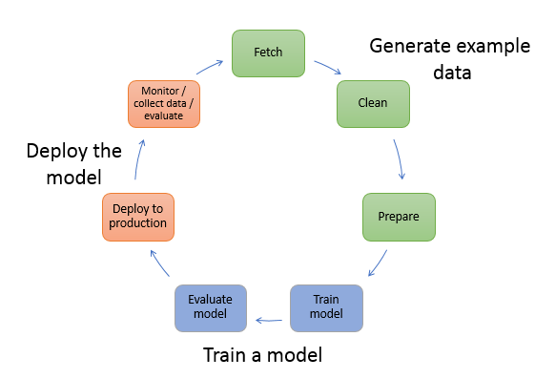
SOLUTION & TECHNOLOGY
Define Dependent Variable
Data Exploration
Choose the best features to train the model
Analyze correlation between variables
Data Preprocessing
Remove unnecessary columns.
Convert categorical variables into dummy variables
Split data into train and test set.
IBM Sample Data – HR Attrition
Deploy model using AWS Chalice (Microframework)
Serverless application that uses AWS S3 as repository and connects to other AWS services.
Create a lambda function to deploy model using the sage maker endpoint.
Visualize results using datables.
Choose the best binary classification model based on accuracy.
XGBoost (Supervised learnin algorithm)
Train Model using AWS Sagemaker (Jupyter)
Create Endpoint in AWS Services to deploy model
Evaluate model using Confusion Matrix
Define optimum cutoff based cost of turnover.

Slide 5
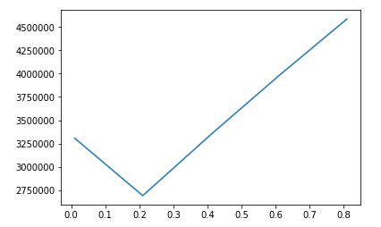
ROBUSTNESS
Overall Classification Rate: (default Cut-off 0.5) | 87.8%
TRAIN – 80%
TEST – 20%
 | No Attrition | Attrition
No Attrition | 89% (366) | 30% (9)
Attrition | 11% (45) | 70% (21)
 | Predicted – True Value | Cost
True positive (TP) | 1 - 1 | $6,000
True negative (TN) | 0 - 0 | 0
False positive (FP) | 1 - 0 | $6,000
False negative (FN) | 0 - 1 | $58,000
Optimal Cut-Off
Cost is minimized near a cut-off of 0.21 for a cost of $270k

Slide 6
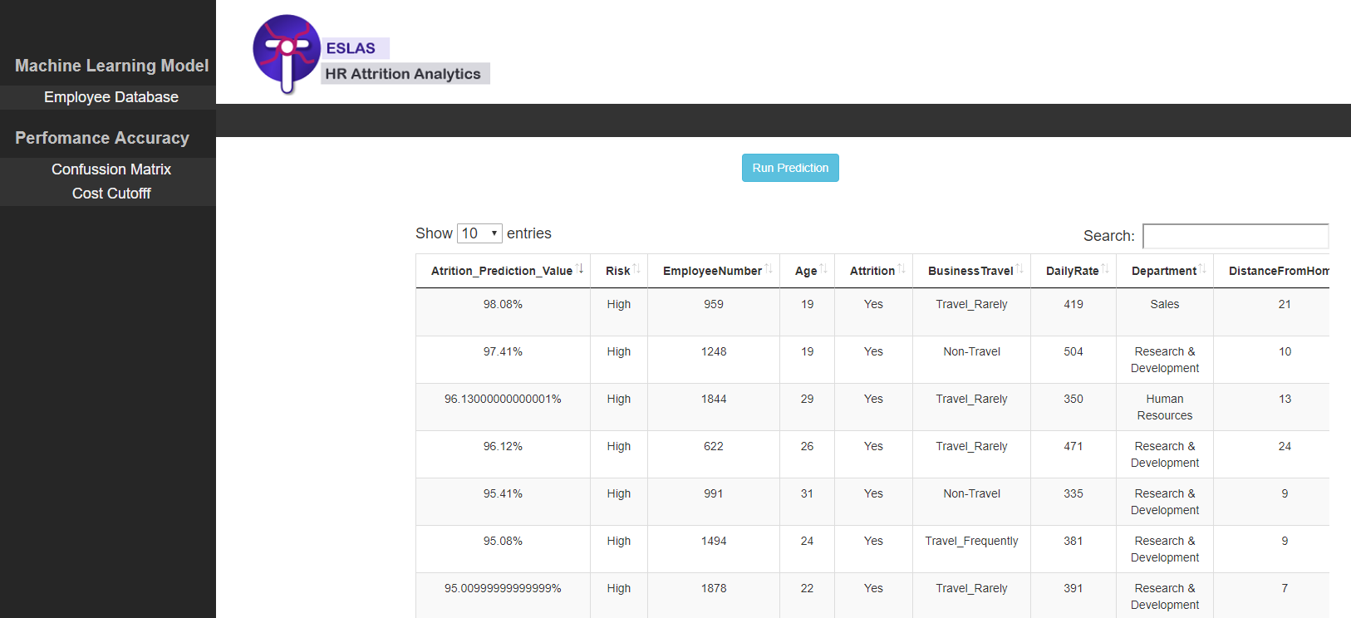
DEMO
https://s3.amazonaws.com/sagemaker-hremployeeattrition-0001/website/pages/EmployeeDatabase.html

Slide 7
BENEFITS
We are able to identify the employees with a higher risk of attrition.
We can focus our efforts to incentivize employees with higher risk of attrition and reduce employee turn over costs.
We can identify the reasons for leaving and do more research on employees with higher risk of attrition to find more relevant reasons for leaving and add them to our model.

Slide 8
Notes:
Usar para separador de capitulos . Seria bom ter esta versao em vermelho e verde tb..

